Slide 1
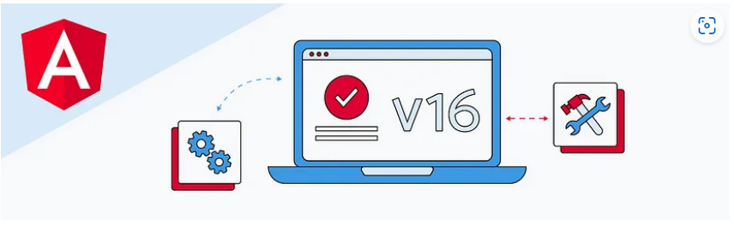
Feature highlights in Angular v16

Slide 2
Topic
Angular Signals developer preview
Enhanced hydration developer preview
Faster builds with the esbuild developer preview
Standalone component migration and scaffolding
Required inputs

Slide 3
Link
Angular v16 is here!. Six months ago, we reached a… | by Minko Gechev | Angular Blog
Angular - Update Angular to v16

Slide 4
Angular Signals
Angular Signals is a system that granularly tracks how and where your state is used throughout an application, allowing the framework to optimize rendering updates.

Slide 5
What are signals?
A signal is a wrapper around a value that can notify interested consumers when that value changes. Signals can contain any value, from simple primitives to complex data structures.

Slide 6
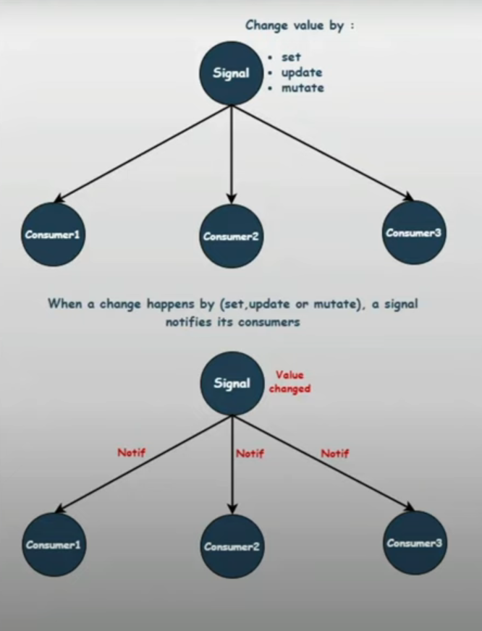

Slide 7
Enhanced hydration developer preview
Server Side Rendering (SSR)
Introduction to server-side rendering with Angular | by Alain Chautard | Jan, 2024 | Angular Training

